Slide 1
News Classification using NLP
-Mr. Sachin Gupta

Slide 2
Problem Statement
The goal of text classification is to automatically classify the text documents into one or more defined categories. Some examples of text classification are:
Detection of spam and non-spam emails,
Categorization of news articles into defined topics.

Slide 3
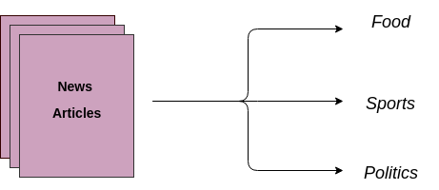
Categorization of news articles into defined topics

Slide 4
Overview of steps implemented
1.Dataset Preparation: The first step is the Dataset Preparation step which includes data gathering and performing basic pre-processing.
2.Feature Engineering: The next step is the Feature Engineering in which the raw dataset is transformed into features , it also includes the process of creating new features from the existing data.
3.Model Training: The final step is the Model Building step in which a machine learning model is trained on a labelled dataset.
4.Improve Performance of Text Classifier: Implementing different Ensemble techniques for better performance.

Slide 5
Dataset Preparation
This is initial step which is followed while building any machine learning model.
In this phase we gathered the dataset which consists of 3 columns
Unnamed 0:Random Id
Article(articles from different section of news)
Category(category to which that article belongs eg.politics,education,etc)
Based on Category we created a new column using factorization which was numerical representation of Category.
We then checked for imbalanced class, here we tend to exhibit that.
We then separated the dependent and independent variables.

Slide 6
Dataset Cleaning using Regex
Text cleaning involves:
Removal of Punctuations.
Removal of Expressions usually speech transcripts like [laughing],[crying],etc.
Removal of Unwanted Spaces.
Lemmatization which involves taking different types of same words of different tenses and converting back to its root form.

Slide 7
Feature Engineering
Count Vectors:Count Vector is a matrix notation of the dataset in which every row represents a document from the corpus, every column represents a term from the corpus. In other words, we built a binary bag of words with 0s and 1s.
TF-IDF Vectors: TF-IDF score is composed by two terms: the first computes the normalized Term Frequency (TF), the second term is the Inverse Document Frequency (IDF), computed as the logarithm of the number of the documents in the corpus divided by the number of documents where the specific term appears

Slide 8
Model Building-I (Using Linear SVC)
The final step in the text classification framework is to train a classifier using the features which we created earlier.
Similar to Linear Support Vector Classification:
SVC with parameter kernel=’linear’, but implemented in terms of liblinear rather than libsvm, so it has more flexibility in the choice of penalties and loss functions and should scale better to large numbers of samples.
This class supports both dense and sparse input and the multiclass support is handled according to a one-vs-the-rest scheme.

Slide 9
Model Testing I-Diagonise Variance Problems
CV error > training set error then it is said to overfit the training set.
To remedy over fitting:
decrease model complexity
for ex: decrease max depth, increase min samples per leaf.
gather more data.

Slide 10
Model Testing I-Diagonise Bias Problems
CV error ≈ training set error >> desired error, then it is said to underfit the training set.
To remedy underfitting:
increase model complexity.
for ex: increase max depth, decrease min samples per leaf.
gather more relevant features.

Slide 11
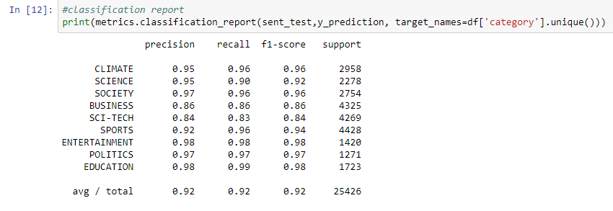
Model Evaluation

Slide 12
Model Building-II(Ensemble Methods)
Bagging
one algorithm.
≠ subsets of the training set.
Voting Classifier
same training set.
≠ algorithms.

Slide 13
Bagging: Classification & Regression
Bootstrap Aggregation.
Uses a technique known as the bootsrap.
Reduces variance of individual models in the ensemble.
Classification:
Aggregates predictions by majority voting.
Regression:
Aggregates predictions through averaging.
Out Of Bag (OOB) instances(can be used for testing the model)
On average, for each model, 63% of the training instances are sampled.
The remaining 37% constitute the OOB instances.

Slide 14
Voting Classifier
Binary classification task.
N classifiers make predictions: P , P , ..., P with P = 0 or 1.
Meta-model prediction: hard voting.

Slide 15
Boosting
Boosting: Ensemble method combining several weak learners to form a strong learner.
Weak learner: Model doing slightly better than random guessing.
Train an ensemble of predictors sequentially.
Each predictor tries to correct its predecessor.
Most popular boosting methods:
AdaBoost
Gradient Boosting.

Slide 16
Gradient Boosted Trees
Sequential correction of predecessor's errors.
Does not tweak the weights of training instances.
Fit each predictor is trained using its predecessor's residual errors as labels.
CART is used as a base learner.

Slide 17
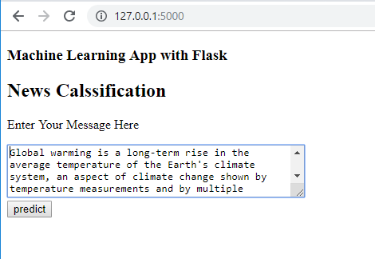
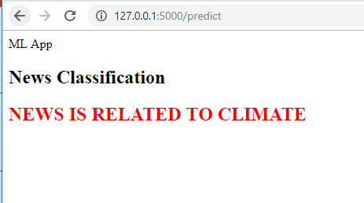
Model Deployment-I (Using Flask)

Slide 18
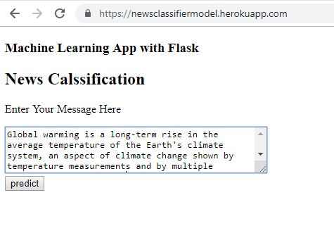
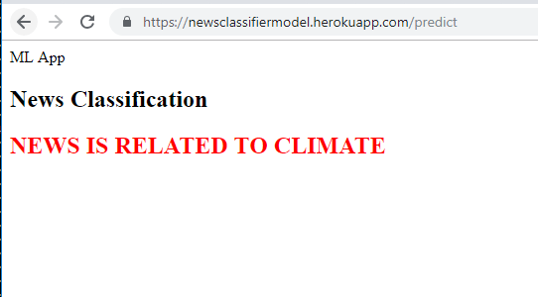
Model Deployment-II (Using Heroku Cloud)

Slide 19
Questions??
Mail-id-sachinsg873@gmail.com

